Slide 1
MIP: Supply Chain Optimization
Ahmad Iftikhar Khan, Anoop Ajaya Kumar Nair, Dipendra Gautam

Slide 2
Overview
Data Link: https://www.kaggle.com/datasets/laurinbrechter/supply-chain-data/data
Problem Statement : For each customer order, identify the best plant for processing and the optimal port for shipping based on the following requirements:
Plant Selection: Each plant can only handle certain types of products and should only be chosen if it can produce the ordered item.
Port Assignment: Each plant has specific ports it is connected to for shipment, restricting it to shipping through those designated ports only.
Vendor Managed Inventory (VMI): Some customers have VMI agreements, which specify which plants are permitted to fulfil their orders.

Slide 3
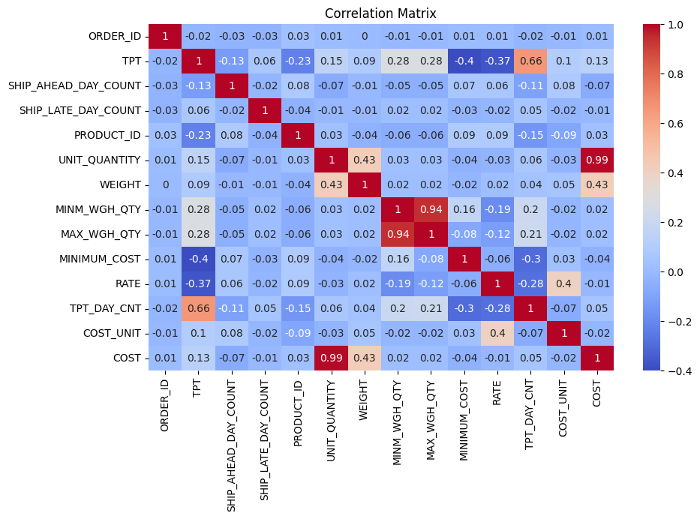
Correlation Matrix of the data

Slide 4
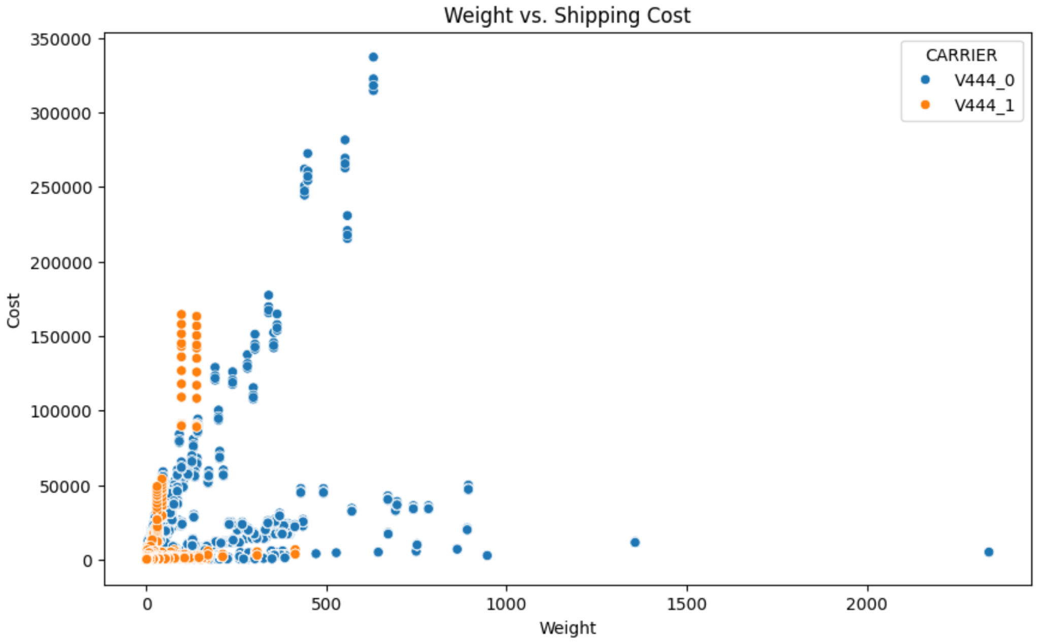
Shipping cost vs weight for carriers

Slide 5
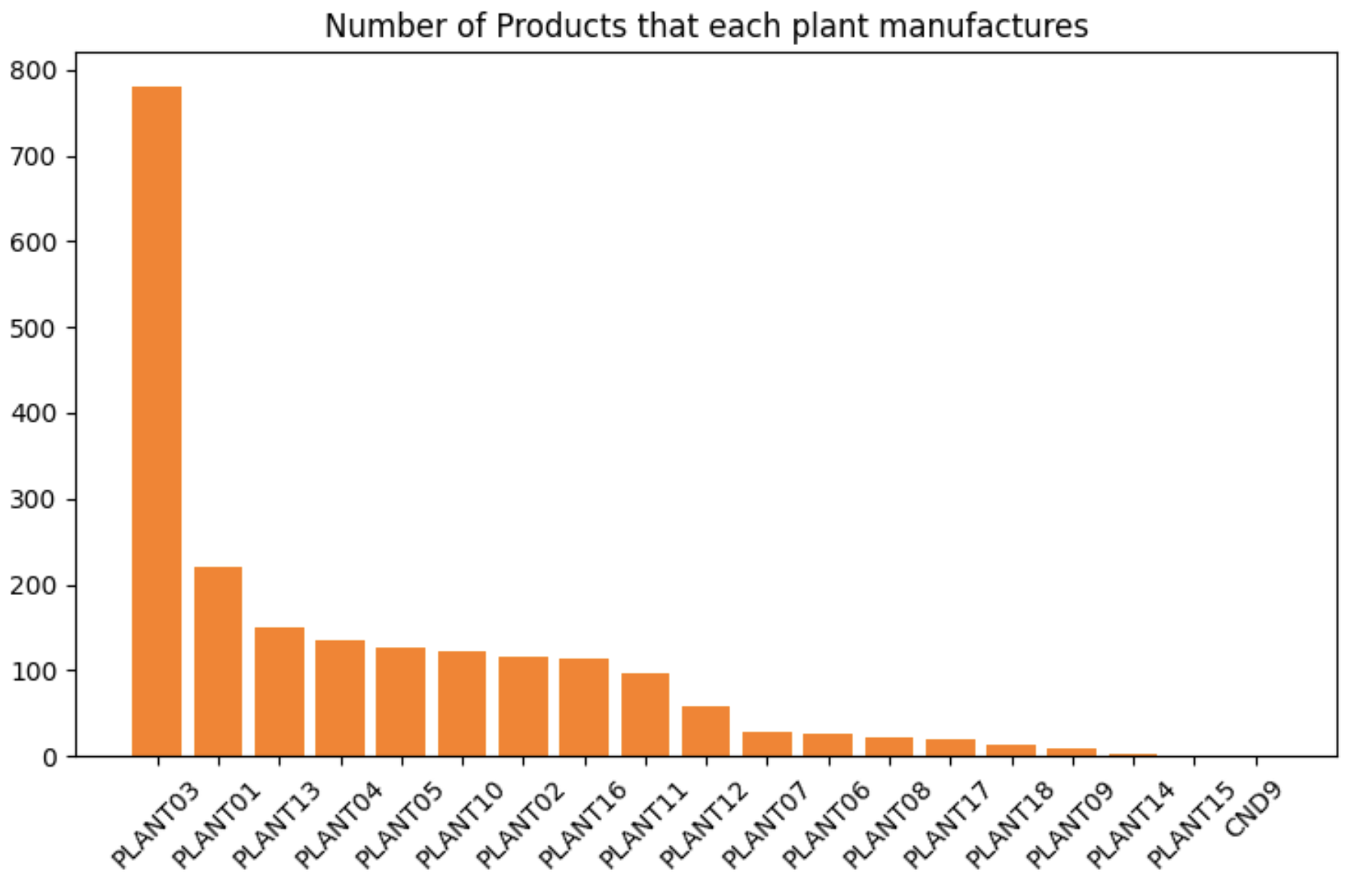
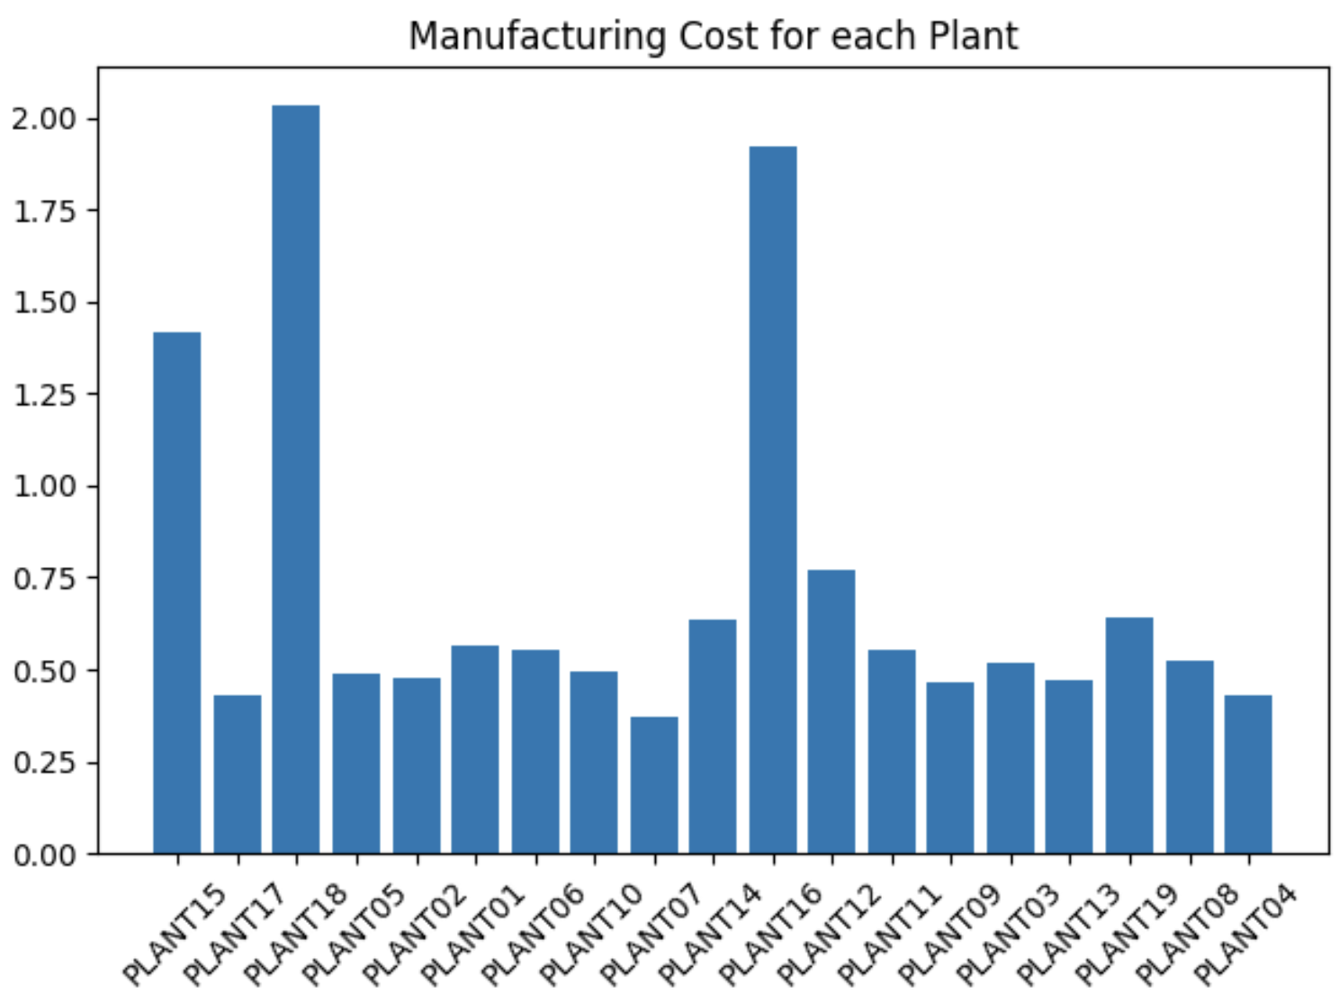
Production plant stats

Slide 6
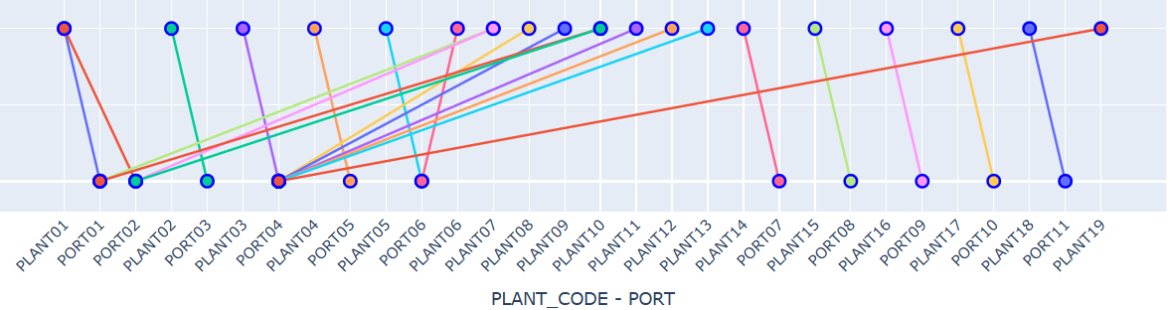
Possible routes!

Slide 7
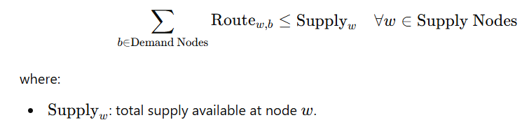
Decision Variables, Objective Function and Constraints
Decision Variable :
Route_{w,b}​≥0
For self-transportation, Route_{w,w}=​=0
Objective Function:
Minimize ∑​_{(w,b)∈Routes}Route_{w,b​}×Cost_{w,b​}
where, Cost_{w,b}​: the per-unit transportation cost from supply node w to demand node b
Constraints:

Slide 8
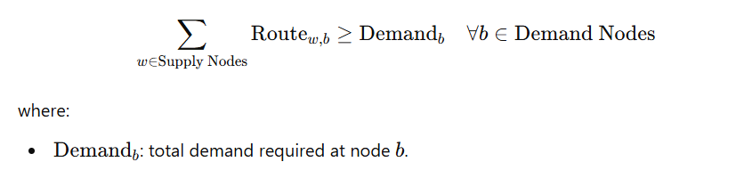

Continued

Slide 9
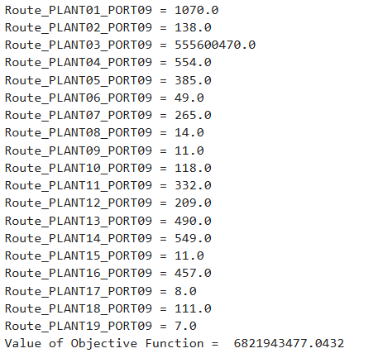
Outcome

Slide 10

Thank you!
Declaration: ChatGPT is used in some parts of the code.

